Slide 1
Creation Myth and Artwork in Native American Storytelling
Student’s Name
Institution Affiliation

Slide 2

Introduction
Storytelling is an inherent part of most indigenous cultures today.
Historic records within tribal cultures include pottery, drawings paintings, weaving and other artistic medium.
It is significant for individuals to interpret the records correctly.
The stories tell about the origin of nations, why animals behave in a certain manner and how cultural traditions originated.
Stories are often told through audio recordings and video.
Notes:
In today’s world, storytelling is an inherent part of most indigenous cultures. Historic records within cultures include pottery, drawings, paintings, weaving, and other artistic media. The precise interpretation of such records is very significant since they tell the origin of nations, why animals behave in a specific manner, and the origin of cultural traditions. The stories are often told through audio recordings and videos of culture, history, and beliefs.

Slide 3
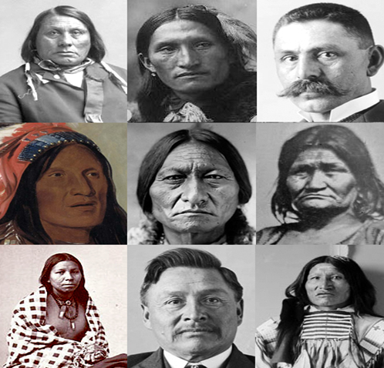
Lakota Tribe
Lakota tribe is a native American group among the subcultures of Sioux people.
They were traditionally nomadic people.
They preserve cosmic harmony by being at the right pace at the right time and performing the appropriate rites.
They survived through fishing, hunting and gathering wild rice.
They considered the Black Hills to be sacred and objected to mining.
Notes:
The Lakota tribe is among the native American groups of the Sioux people subcultures. They were traditionally nomadic people. The Lakota preserve cosmic harmony by being at the right place and the right time and performing the appropriate rites. The tribe survived through fishing, hunting, and gathering wild rice. The Lakota considered the Black Hills to be sacred and objected to mining, and they have carried their past through oral tradition for centuries.

Slide 4

Geography of the Lakota Tribe
The traditional homeland of the Lakota is the Black Hills between Wyoming and South Dakota (Twenter, B. J. (2016).
They also lived in the region around Lake Superior in the early 16th century.
They originated from lower Mississippi river and relocated to Ohio Valley.
Most Lakota live in Rapid city, and other small towns in Metro Denver and Black Hills.
Conflicts with Cree and Anishnaabe pushed the Lakota to the Great plains in the west.
Notes:
The traditional homeland of the Lakota is thought to be the Black Hills between Wyoming and South Dakota. The tribe is also believed to have lived in the region around Lake Superior in the early 16th century. The Lakota originated from the lower Mississippi and relocated to Ohio Valley. The conflicts with Anishnaabe and Cree tribes pushed the Lakota to the Great Plains in the west. Most Lakotas live in Rapid city and small towns in the Black Hills.

Slide 5

Themes in Lakota Tribe
A significant theme in the Lakota stories is the link between people and land.
Individual and tribal identity is often associated with the land and the heroes in the tribe.
The themes in Lakota woman are the formation and reclamation of identity and intersection of politics, identity and justice.
Also, an important theme among the Lakota is learning the ways of the earth, how to walk on the earth and how to pray.
The theme of war and oppression is also evident among the Lakota.
Notes:
A significant theme in the Lakota tribe is the connection between the people and the land. Individual and tribal identity is linked with the land and heroes of the tribe. Themes among Lakota women include the formation and reclamation of identity and the intersection of politics, identity, and justice. Besides, learning about the earth's ways, how to walk on it, and praying is a significant theme in the Lakota tribe. The theme of war and oppression is also evident among the Lakota as they defended their land against the administration and protected the sacred Black Hills.

Slide 6
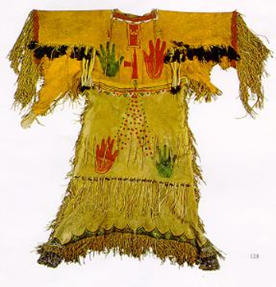
Artwork Among Lakota
Lakota art include information from the Ghost Dance of 1890 which greatly influenced leather bead shirt design.
Women were known for their quill and beadwork (Monahan, 2018).
Men were known for painting beautiful images on cured buffalo hides.
Decorated hide shirts were symbols of bravery earned through war.
Men used animal and human images to show hunts, battles and tribal history (Monahan, 2018). Women painted colorful geometric designs.
Notes:
Lakota art included information from the 1890 Ghost Dance, which significantly influenced leather bead shirt design. Women were known for their beadwork and quill while men painted beautiful images on cured buffalo hides. Decorated hide shirts were symbols of bravery earned through battle. Men used animal and human images to show history, war, and hunts, while women painted colorful geometric designs.

Slide 7

Lakota Mythology
The exploits of Iktomi, the fraud spider deity, is among the well-known stories from Lakota folklore.
The slaying of Unhcegila , a serpent monster who wrecked havoc upon the land and killed those who stumbled upon her is also a recognized myth among the Lakota.
The Lakota consider the Rock , Inyan , to be omnipresent and the maker of earth.
They trust that everything has a spirit and an afterlife exists after one is dead.
They believe that an individuals life will go to a happy hunting ground, with plenty of animals to hunt than in the living world.
Notes:
The Lakota believe that all things possess a spirit, and there is an existence of an afterlife. Besides, they think that the rock, Inyan, was omnipresent and created and controlled the earth through his power. Also, the adventures of Iktopmi, the trickster spider deity, is among the well-known stories from Lakota mythology. Additionally, the slaying of Unhcegila, a serpent monster that wrecked disorder upon the land and killed those who stumbled upon her, is a recognized myth among the Lakota. The Lakota believe that an individual’s life will go to a happy hunting place after death, where there are plenty of animals to hunt than in the living world.

Slide 8

Lessons Portrayed by the Lakota Story
Oppressed individuals who were forced away from their land maintained connection with their native homeland.
Relating to culture ensures that individuals maintain and hunt down knowledge.
Morals and ethics are a significant aspect in every tribe.
Tribes maintain their beliefs, tribe origin and myths from one generation to another.
It is significant to preserve the culture of a tribe since it plays an essential cultural and educational role to the natives.
Notes:
From the Lakota story, people can learn that oppressed individuals forced out of their land maintain a connection with their native homeland. Relating to culture is an effective way of ensuring that people hold and hunt down knowledge. Morals and ethics are significant aspects in every tribe. Tribes maintain their myths, tribe origin, and beliefs for one generation to another. Tribes need to preserve their culture since it plays a significant cultural and educational role to the natives.

Slide 9
References
Monahan, K. L. (2018). Collecting During the Indian Craze: Analyzing the Harry L. George Collection of Native American Art.
Twenter, B. J. (2016). Lakota Emergence. Transmotion, 2(1&2), 180-180.

